Slide 1
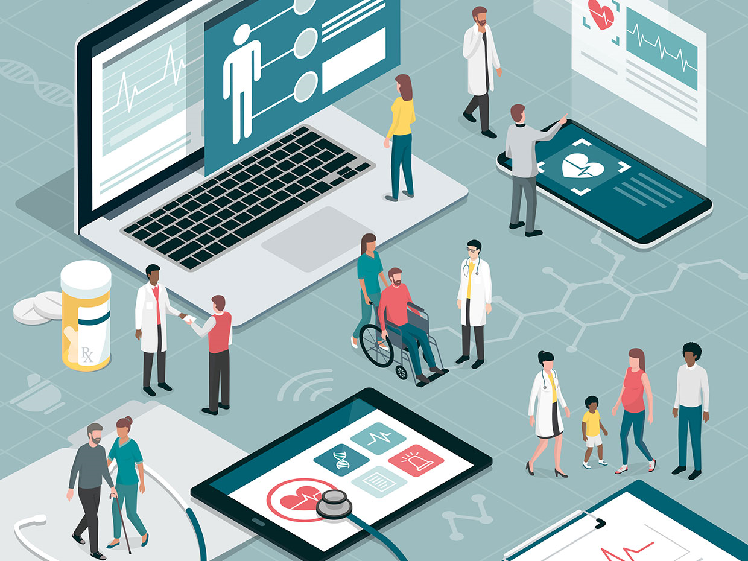
Smart Healthcare Network

Slide 2





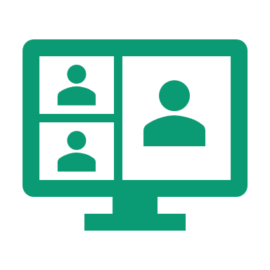
Agenda
What is a Smart Hospital
Martina Greco Marta La Franca Miguel Monteiro
Hospital Management System
Authors
Smart devices
Telemedicine

Slide 3
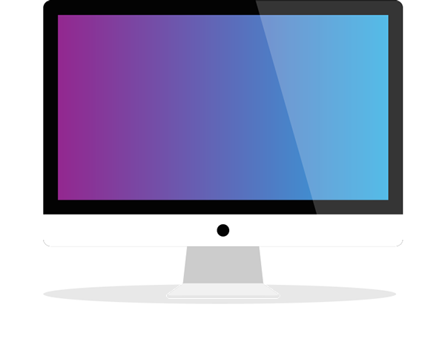
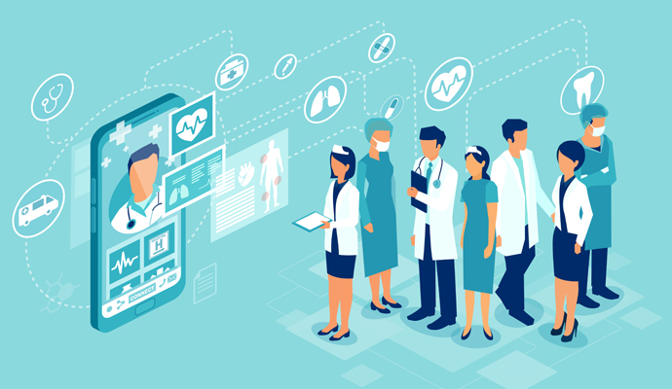
What is a Smart Hospital?
Smart hospitals are hospitals which optimize, redesign and/or build new clinical processes, management systems and maybe even infrastructure, all enabled by underlying digitized networking infrastructure of interconnected assets, to provide a valuable service, to achieve better patient care, experience and operational efficiency.
As the population grows and ages more quickly than ever before, pressures on the healthcare system will only increase as time goes on.
All countries face major challenges to ensure that their health and social systems are ready to make the most of this demographic shift.
Laws are becoming stricter and more complex.

Slide 4
What is a Smart Hospital?
In addition to all of this, the demand for healthcare services is rapidly increasing especially in the current COVID-19 crisis.
Furthermore, today's world is rapidly evolving but our hospital infrastructure is often left to play catch up, there are countless hospitals that are over 100 years old and are still in operation, they have very limited possibilities for advancement, yet they are having to deal with the increased demand, and they can not do this with the infrastructure and technology that they currently have.
The pandemic has placed the healthcare industry under immense pressure, any technology that presents a solution is welcome.

Slide 5
What is a Smart Hospital?
Digitalization isn't just about emailing referrals or booking visits online but it's about better managing the emergency department, coordinating care and accelerating innovation.
Faster admissions, faster discharges, less bureaucracy and waiting.
Smart Hospitals make care more effective and improve the work of doctors and nurses.
The digital transformation of the healthcare industry can help hospitals to achieve key advantages such as better productivity, efficient asset, resources management, and operating costs reduction.
These will, therefore, culminate into a desired patient satisfaction and affordable services.

Slide 6
Hospital Management Systems
Hospital management system
Patient Management
Admissions During stay Discharges
Resources Management
HR Equipment and spaces efficient usage Suplly chain
Big Data Processing
Data collection Data storage and protection Data disposable
Financial Management
Finance Accounting Investments

Slide 7
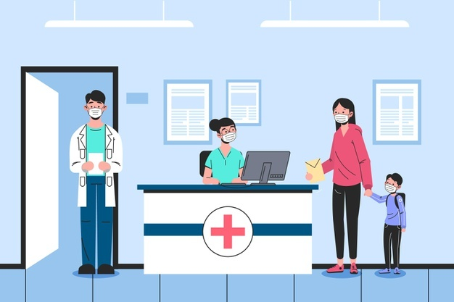
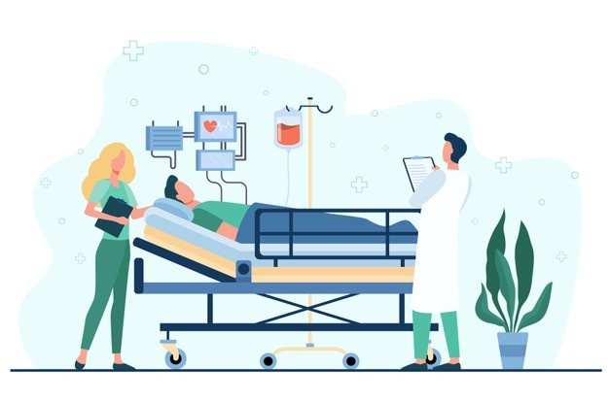


Hospital Management Systems
Patient management
Admissions
Communication between hospitals
Primary healthcare and first responders
Patient Data collection
Triage Assessment with AI or machine learning.
Care givers are updated in real time about patient condition.
In hospital services
Medication and treatment
Patient live tracking
Efficient scheduling
Discharges
Production of a complete medical report and its integration on the patient's file
Production of an easy-to-understand report of the next steps patients should take after discharge

Slide 8

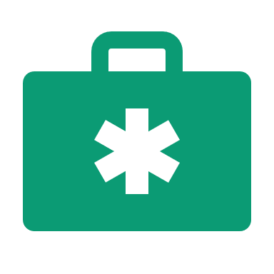

Hospital Management Systems
HR
Equipment efficient usage
Resources Management
Spaces efficient usage
Supply chain

Slide 9

Hospital management systems
Big Data Processing
Data collection: Easy and intuitive internal operations management UI. Simplified External usage UI.
Data storage and protection: Different levels of access to information Stakeholder data should be stored under high standard security protocols and systems.
Data disposal: Compliancy with the country laws for data storage and disposable.

Slide 10

Hospital management systems
Financial management
Insurance processing
Automation of processes
Aim for financil stability
Possibility of further investment
FINANCE
ACCOUNTING
INVESTMENTS

Slide 11
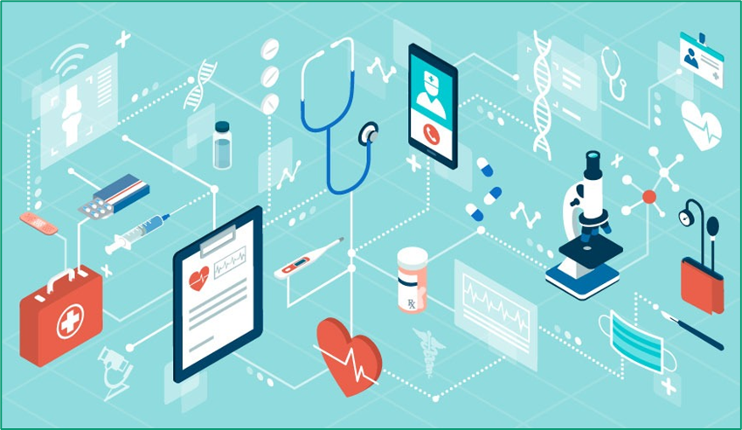
What is Internet of Things?
The Internet of Things (IoT) refers to the process of connecting everyday physical objects to the Internet, from the most familiar items used in the home, to resources in healthcare such as medical devices and wearable devices.
It is a system of physical devices that receives and transfers
data over wireless networks, with limited manual intervention.
IoT-based technologies are able to:
guarantee greater security;
guarantee better efficiency;
guarantee less waste;
lighten the load of technical and administrative tasks that are entrusted to hospital facilities and staff.

Slide 12
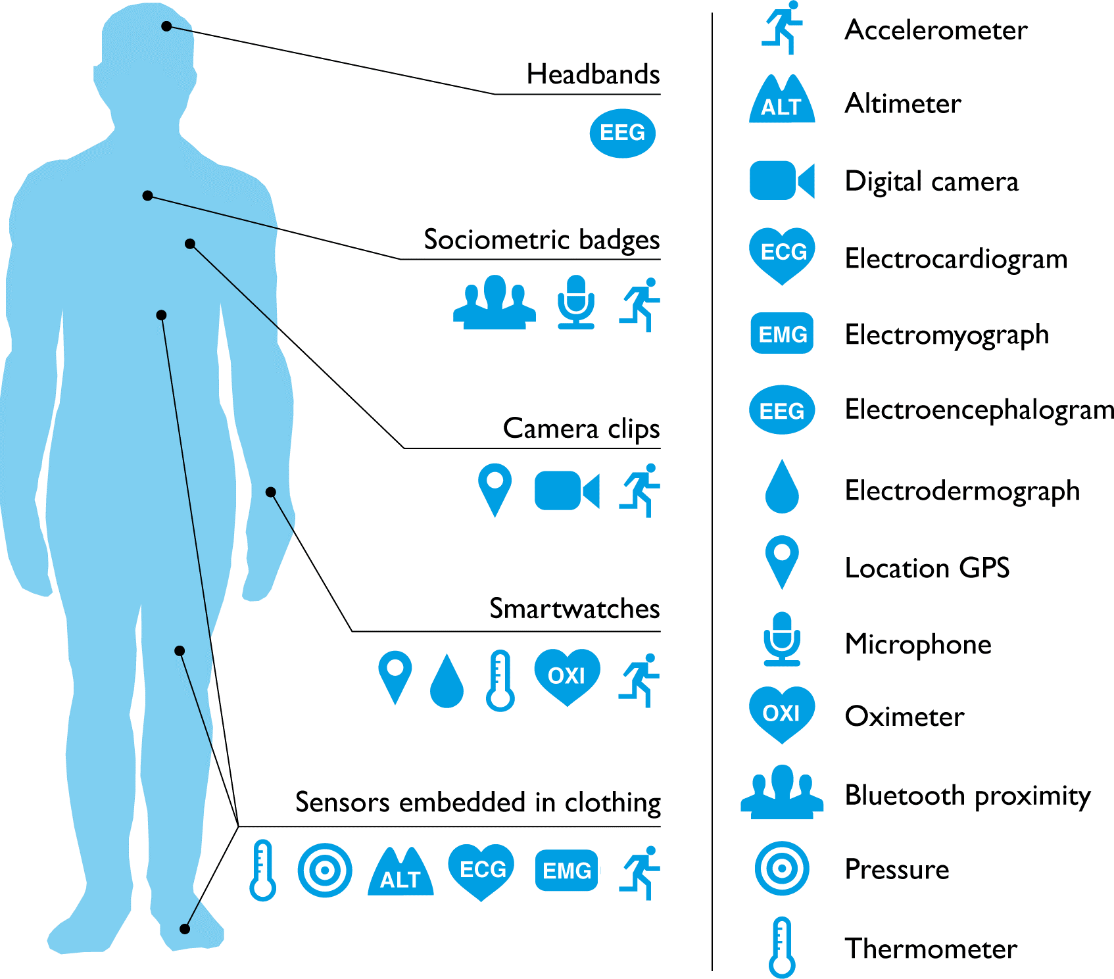
IoT in Healthcare
IoT is a wirelessly communicating system of app and device that connects patients and health providers to diagnose, monitor, track and store vital statistics and medical information.
Few examples of IoT in Healthcare
Headsets that measure brainwaves
Clothes with sensing devices
Glucose monitors
ECG monitors
Pulse oximeters
Sensor embedded in medical equipment,
surgical robots and device implants
Any wearable technology device

Slide 13



Wereable devices
Universally accessible
Durability
Reliability
Compact size
Wearables are smart electronic devices and technologically sophisticated, equipped with some sensors that placed in contact with the body monitor the state of health and well-being, that's why they are called "wearables".
ADVANTAGES
Physiological Sensing
Not high battery life
Privacy
Costs
Difficulty of use
Biochemical Sensing
DISADVANTAGES
Motion Sensing

Slide 14
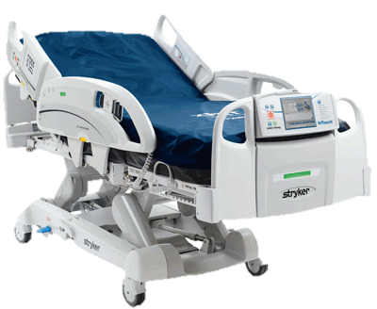
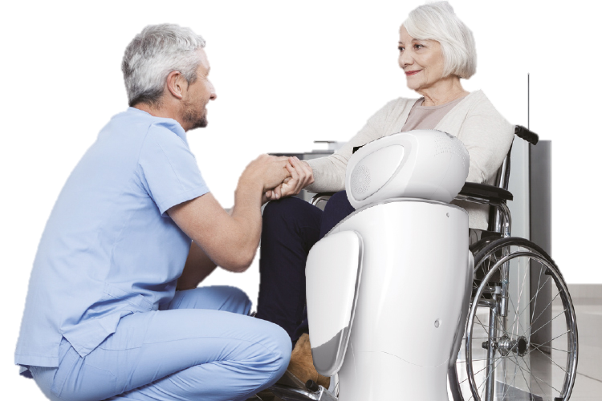
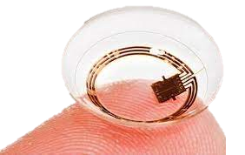
Smart devices
Smart bed allow for real-time monitoring, caregiver and patient assistance, automated functions and positions (chair, assisted exit from bed).
Presence of pressure sensors.
Socially interactive robots (SAR) currently exist only on an experimental level.
They should be able to:
automate some physical tasks that an older person may not be able to do;
promote physical and cognitive exercise;
keep people company in the public areas of residential facilities to improve the socialization of residents.
One non-invasive diagnostic tool are smart contact lenses, which use a microchip and incredibly small electronics to measure the sugar content of tears once per second, which allows glucose levels to be monitored.

Slide 15
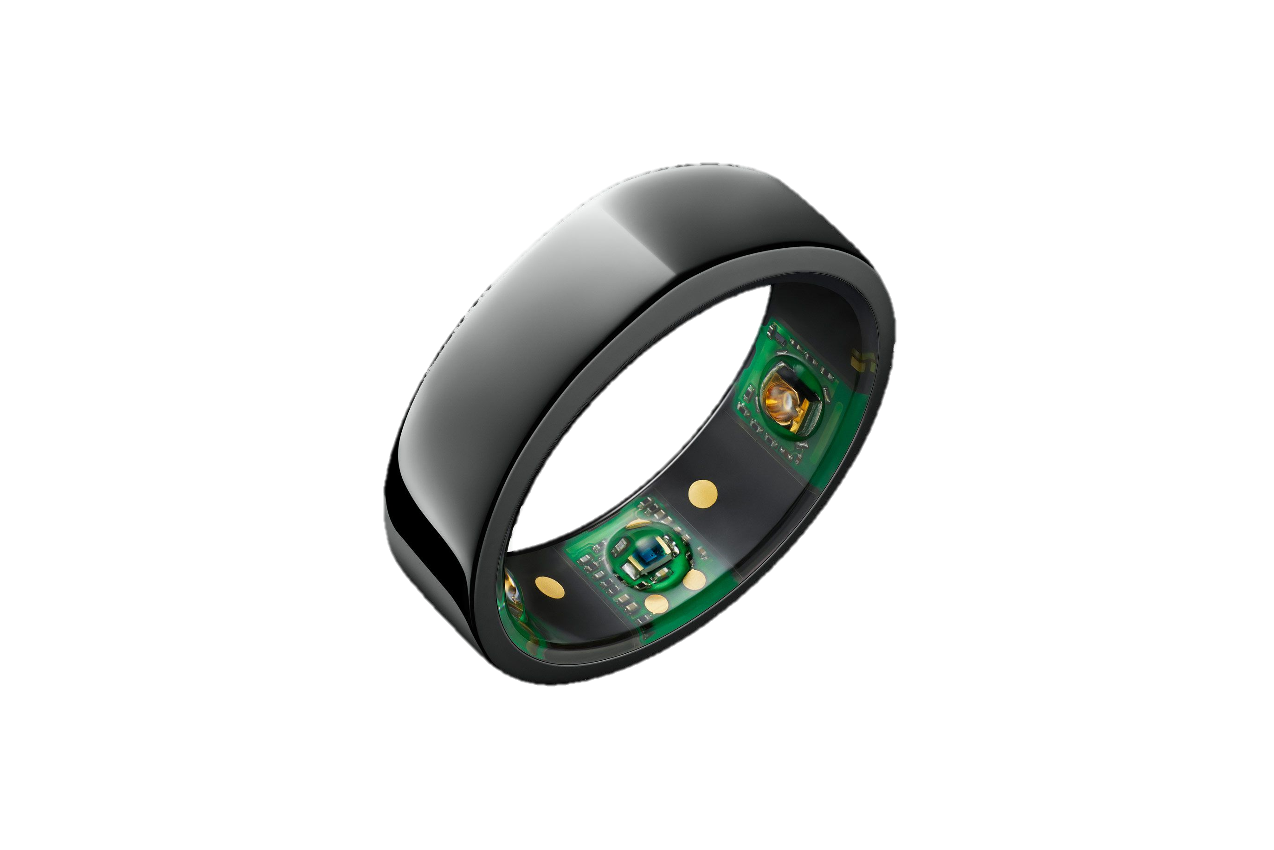
Wearable devices and Covid-19
The technology ring is a wearable device that could be a breakthrough in Covid-19 prevention.
It provides continuous data on the temperature of the person wearing it.
Detects the onset of fever in advance
Main symptom of
Sars-CoV-2 infection

Slide 16
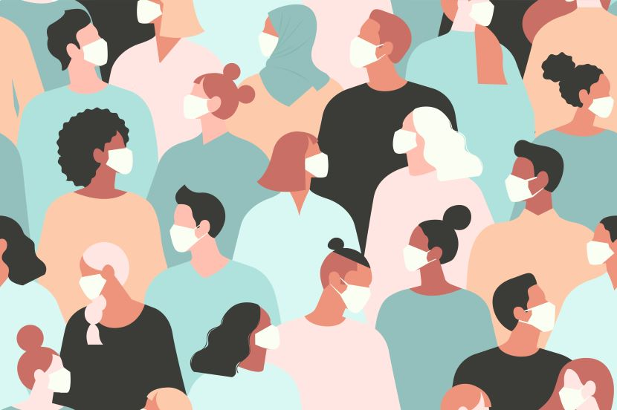

What is telemedicine?
Telemedicine can be defined as the use of technology (computers, video, phone, messaging) by a medical professional to diagnose and treat patients in a remote location.
Telemedicine allows health care professionals to evaluate, diagnose and treat patients at a distance using telecommunications technology.
Telemedicine involves the use of electronic communications and software to provide clinical services to patients without an in-person visit.

Slide 17
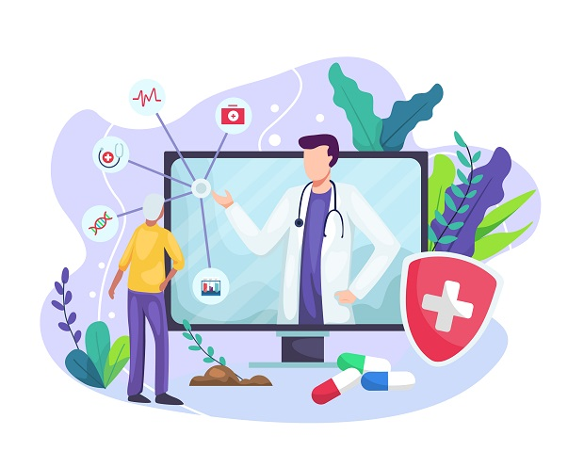
Applications
Follow-up visits
Using health software for routine follow-up visits is not only more efficient for providers and patients, but it also increases the likelihood of follow-up, reducing missed appointments and improving patient outcomes.
Remote chronic disease management
The increasing rate of chronic disease is a major challenge for our health system. It is a prime candidate for the use of telemedicine software because it makes it easier and less expensive for patients to maintain control over their health.
Remote post-hospitalization care
One telehealth program for patients with congestive heart failure reduced 30-day hospital readmissions by 73 percent and six-month readmissions by 50 percent.

Slide 18
Applications
Preventative care support
Weight loss and smoking cessation are the keys to reducing heart disease and a host of other conditions. Telemedicine can be a valuable tool in connecting providers with patients to make sure they get the support they need to be successful.
School based telehealth
When children become ill at school, they might visit a school nurse or be picked up by their parents and taken to an urgent care center. Some innovative districts have teamed up with doctors to conduct remote visits from the school. The provider can assess the urgency of the case and provide instructions or reassurance to parents.
Assisted living center support
Telemedicine software has already proven to be useful in keeping residence of assisted living facilities out of the hospital. Problems often occur at night or on weekends, making hospitalization the only option even for less urgent problems. With telemedicine, on-call doctors can conduct a remote visit to determine if hospitalization is necessary.

Slide 19




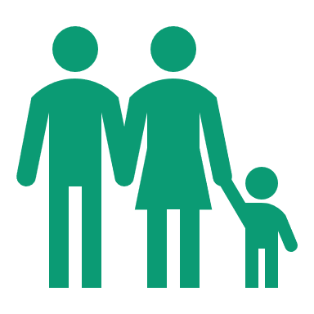
Telemedicine Benefit
Less time away from work
No travel expenses or time
Patients enjoy
Privacy
No exposure to other potentially contagious patients
Less interference with child or elder care responsibilities

Slide 20




Telemedicine Benefit
Increased revenue
Improved office efficiency
Providers enjoy
Better patient follow through and improved health outcomes
Fewer missed appointments and cancellations

Slide 21

What about privacy?
Because patient data will be transmitted when telemedicine is used, it is often subject privacy regulations (for example the HIPAA regulations in the USA, or GDPR in EU).
Consumer video services like Skype and Facetime do not meet this standard. Indeed, any data that is related to a person's physical or mental health is considered personal and protected data under GDPR
In order to maintain compliance, providers must choose technology solutions that use data encryption to protect patient data.

Slide 22
Thank you for your attention

